Slide 1
Beam It: Prototype Demo
Giannina Duran, Josh Sohan, Ernst Masseant

Slide 2
Beam It
A communication device that uses light to transmit data and is low cost/power.
Concept: Send digital data using an LED; known as Li-Fi
Our objective is to design and implement transmitter and receiver modules. These modules will work together to send and display text data from one microprocessor to another.
“Li-Fi is ideal for high density wireless data coverage in confined area and for relieving radio interference issues. Li-Fi provides better bandwidth, efficiency, availability and security than Wi-Fi and has already achieved blisteringly high speed in the lab. By leveraging the low-cost nature of LED’s and lighting units there are many opportunities to exploit this medium, from public internet access through street lamps to auto-piloted cars that communicate through their headlights.” - B.M. Embedded Solutions

Slide 3
Tasks Accomplished
Designed and implemented an analog transmitter
Designed and implemented an analog receiver
Ability to send audio data through light
Designed and executed a digital transmitter
Designed and executed a digital receiver
Was able to successfully transmit digital data in the form of text
Incorporated two LCD screens and one Keypad to type and display the text data being transmitted
Done with the final presentation. We were able to send data over 14 feet.
We design the PCB boards and make them work

Slide 4
Remaining Challenges
Design our PCB boards
Improve our analog transmitter system
Look for a more stable method to receive digital data
Increase speed and distance

Slide 5
Parts List
1 - DIGITAL PWM LEONARDO microcontroller
1 - Arduino MEGA 2560
1 - Keypad
1 - Photoresistor
2 - LCD screen
1 - 20K Potentiometer
1 - 10k Potentiometer
Breadboard
3 - LEDs
1 - LM358 Op Amp
2 ( 220k) Resistors
1 (10k) resistor
KY-008 LASER TRANSMITTER
3W LED MODULE

Slide 6
Proposed Changes in Design
We had a difficult time finding a reliable and stable method to pick up the digital data on the receiver.
We tried different methods such as Solar panels and photodiodes and in the end we concluded that photoresistors were the best that we have tested so far.
Potential Changes could be implemented depending on if we find a method that is more reliable.

Slide 7
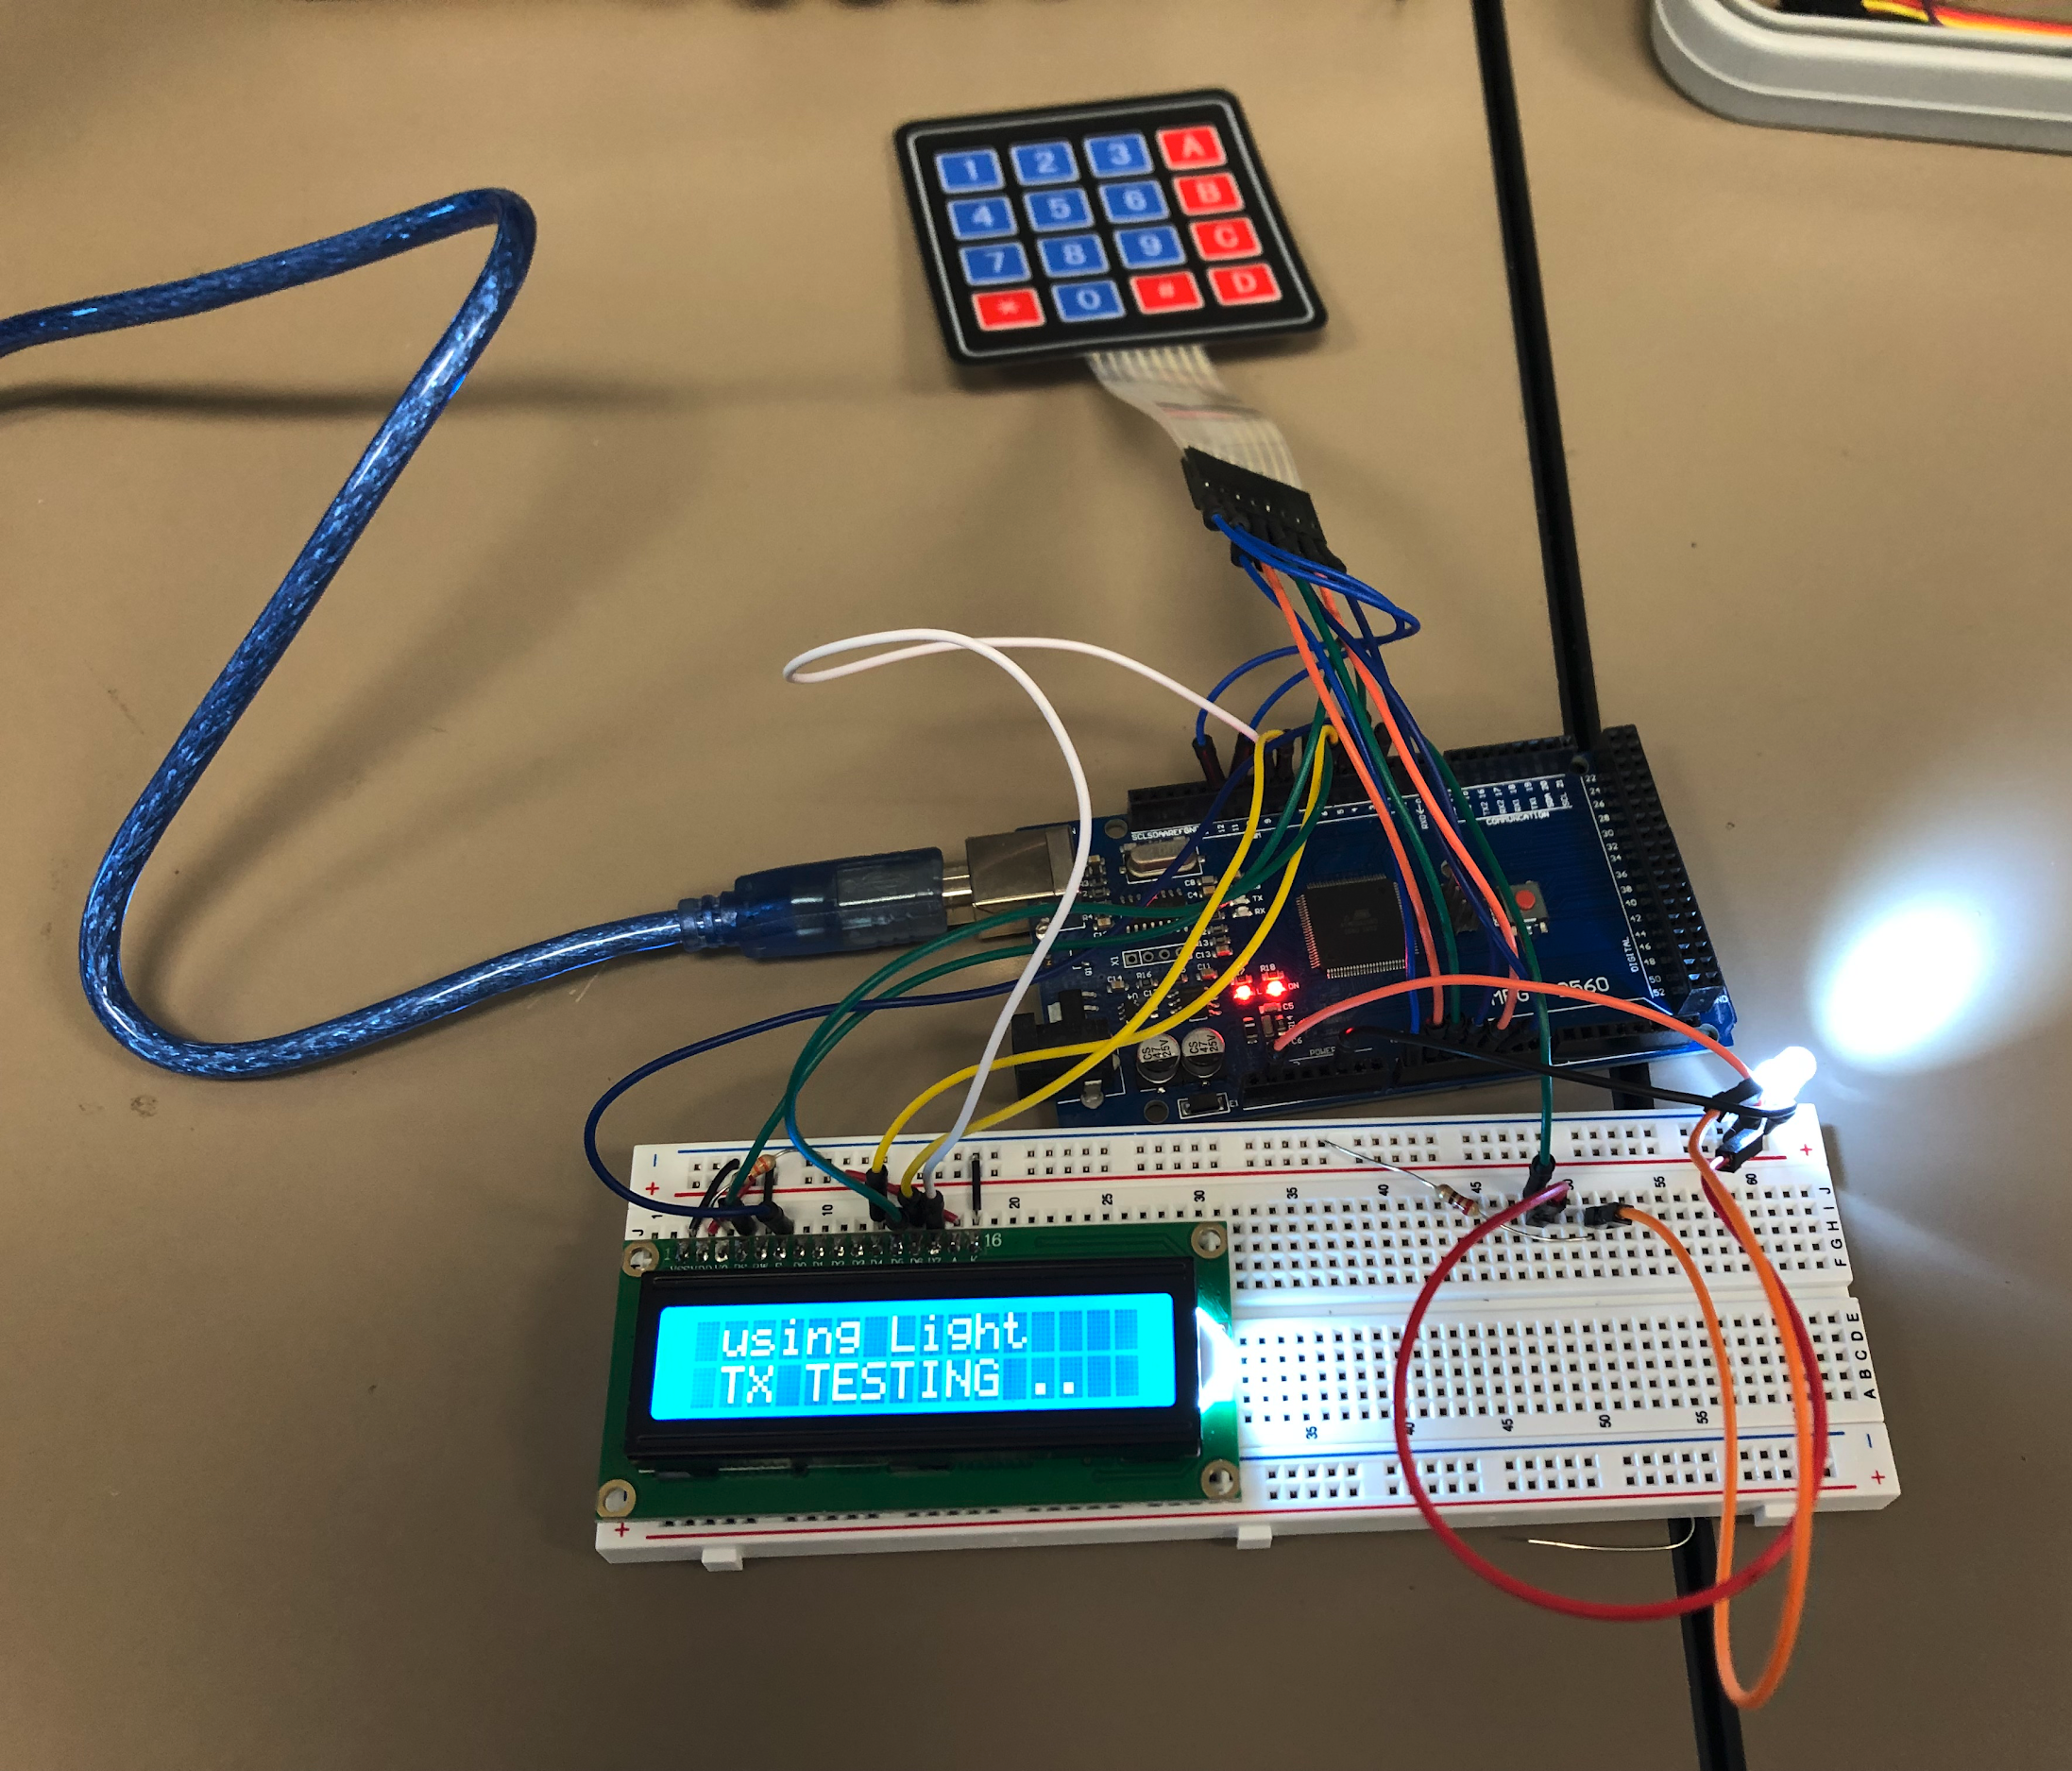
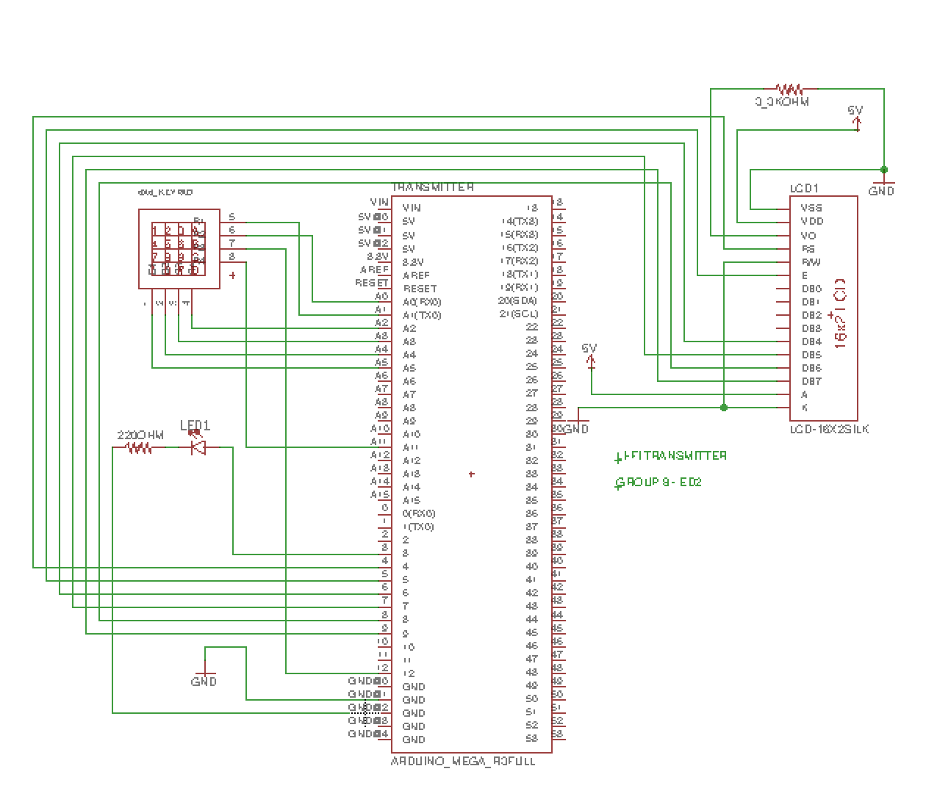
Design of System: Transmitter
TX Testing on Li-Fi System

Slide 8
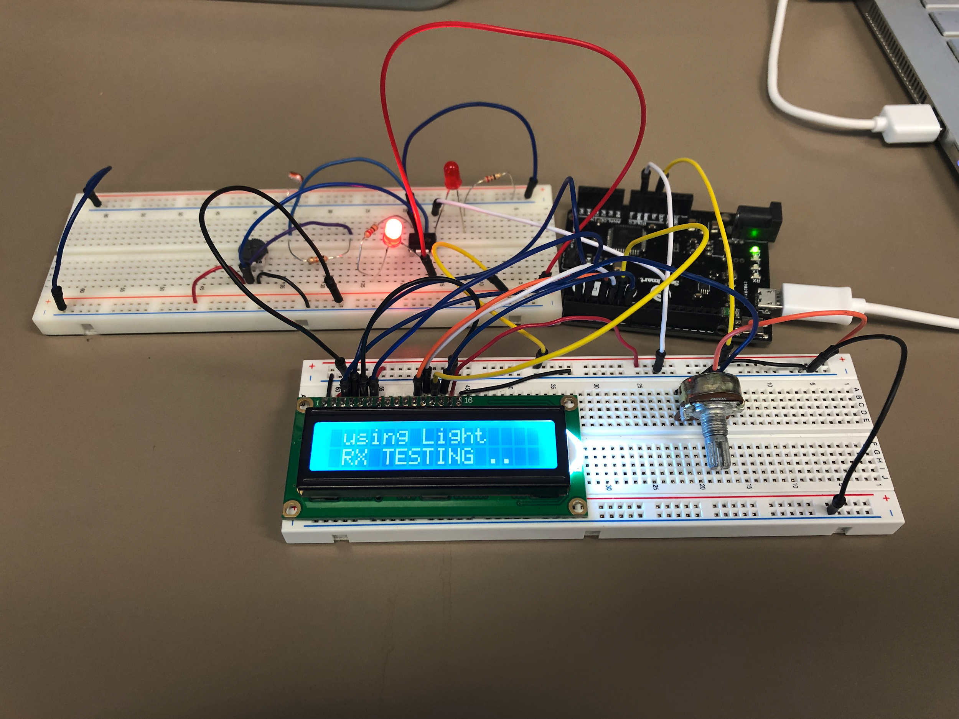
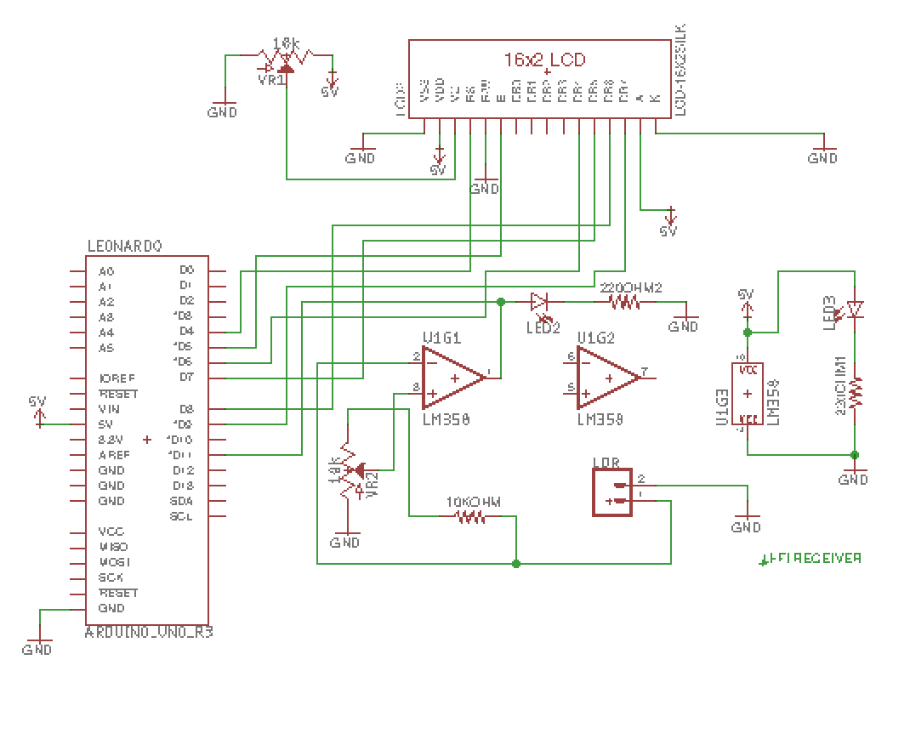
Design of System: Receiver
RX Testing on Li-Fi System

Slide 9
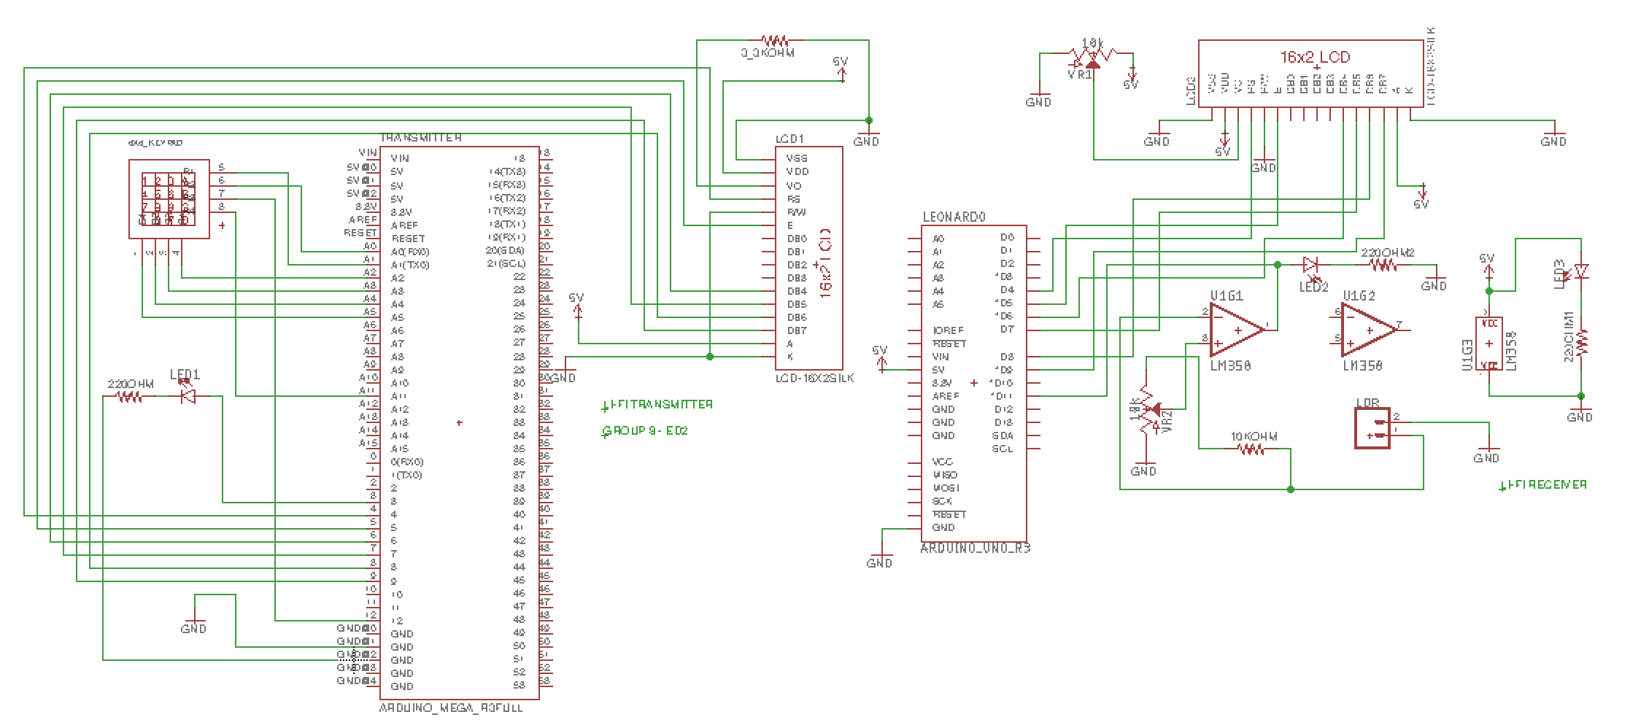
Design of System: Full Li-Fi Overview

Slide 10
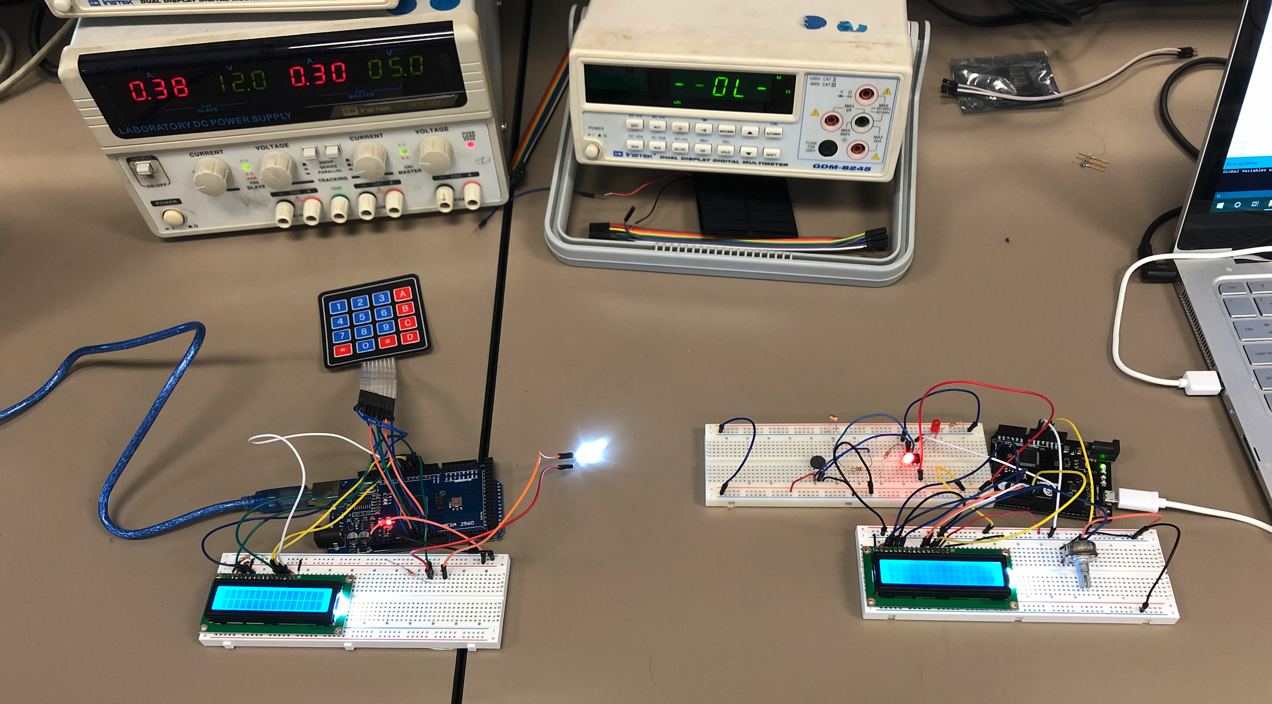
Design of System: Full Li-Fi Overview

Slide 11
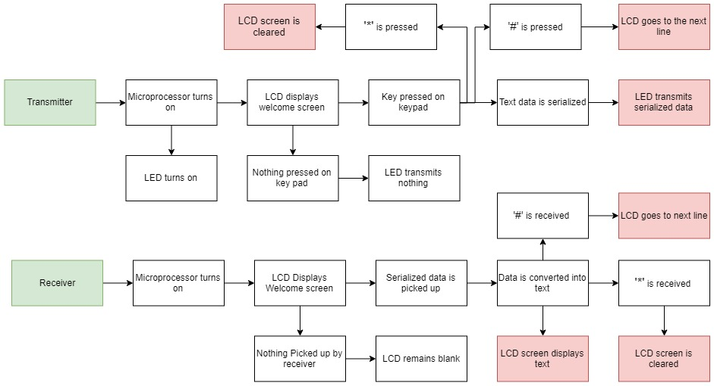
Flow Chart

Slide 12
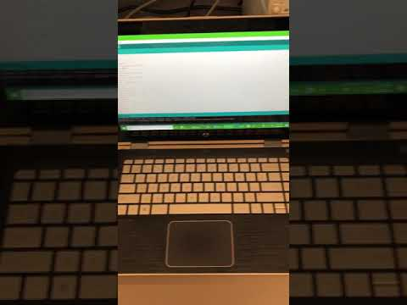
Prototype Demo: Transmitter Breakdown
Link

Slide 13
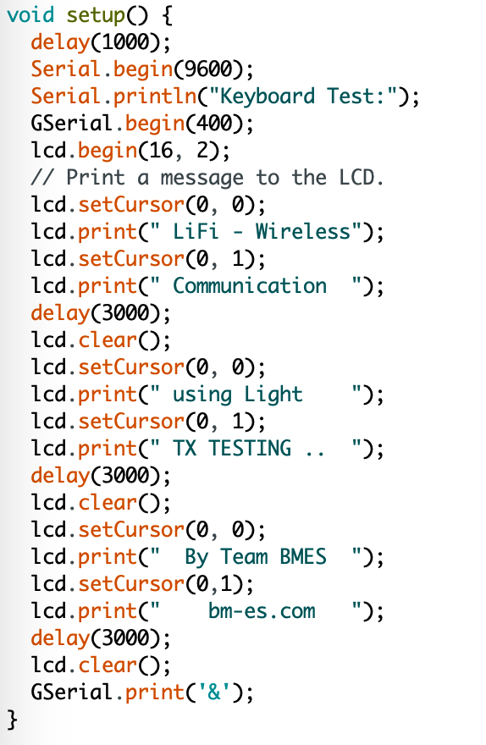
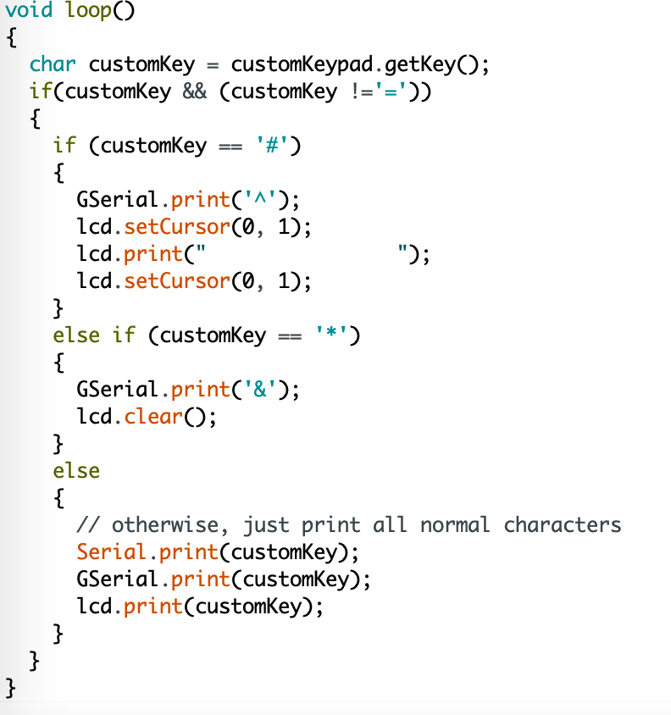
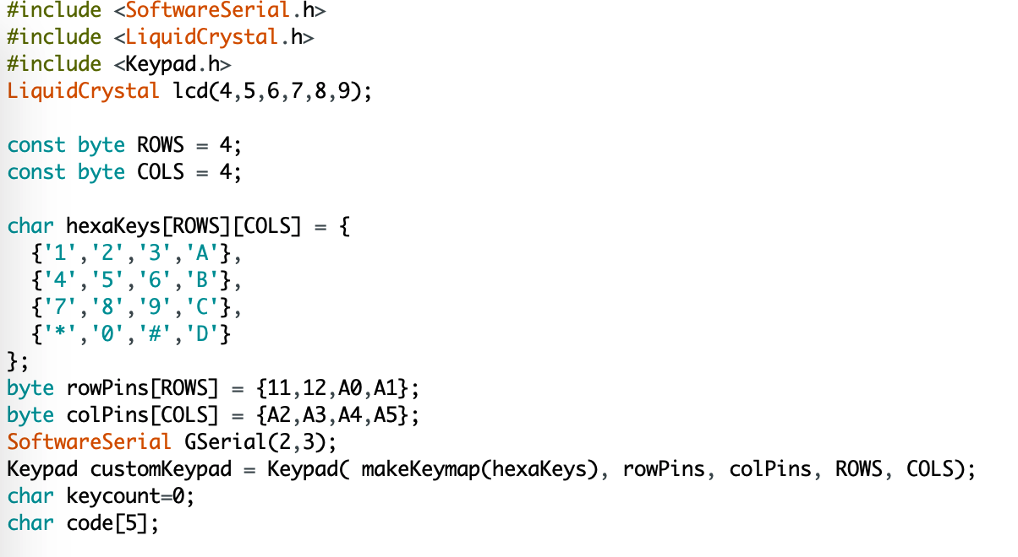
Prototype Demo: Transmitter Code

Slide 14
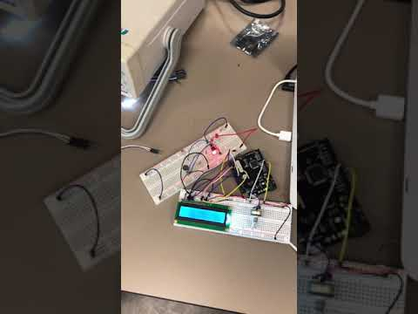
Prototype Demo: Receiver Breakdown

Slide 15
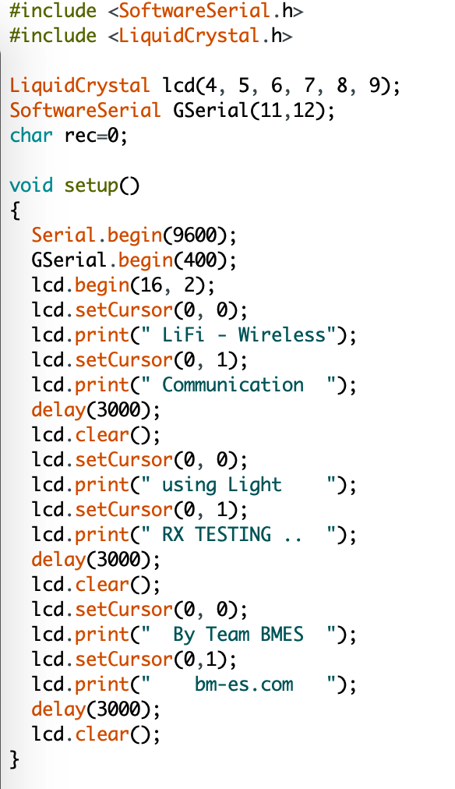
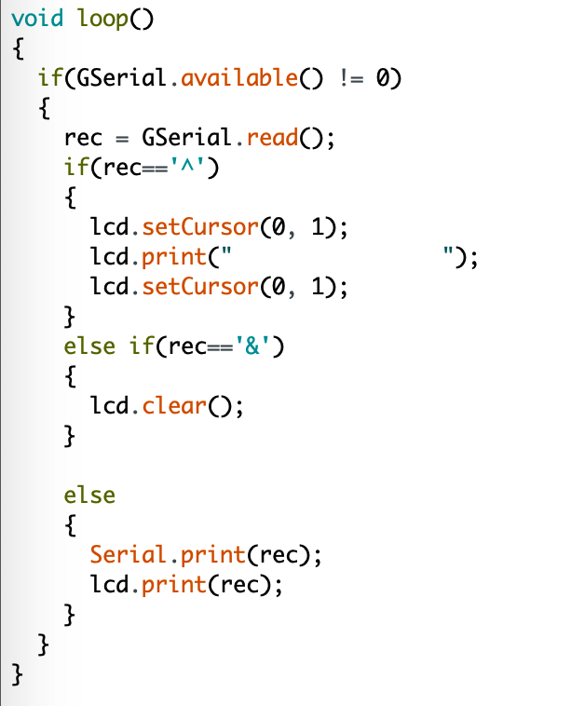
Prototype Demo: Receiver Code

Slide 16
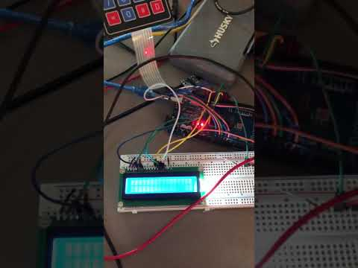
Prototype Demo: Final Result
Link

Slide 17
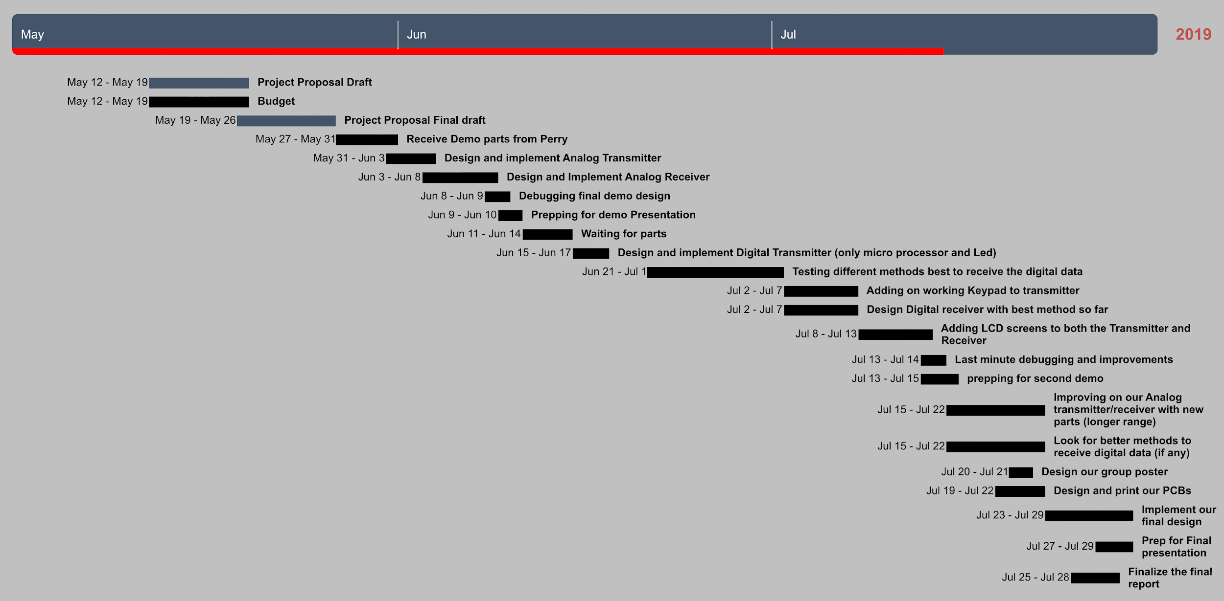
Gaant Chart

Slide 18
Final Design system with PCB Boards

Slide 19
Final video presentation

Slide 20
Conclusion
After multiple prototypes, we found that our system worked best with a laser on the transmitter. As a result, both our transmitter and receiver were able to communicate effectively. The Beam It! system was successful as it allowed us to send and receive text as well as audio.

Slide 21
Thank you!
Questions?

